Slide 1

Part A: Object-Oriented Design
Abu Saleh Musa Miah (PhD)
Notes:
Object-Oriented Analysis and Design: Good software design begins before coding. After establishing the initial software requirements, design practices involve two main activities: conceptual design and technical design, importance of design and object-oriented thinking, and how to design software using techniques like CRC cards.

Slide 2
Presentation Outline
Object-Oriented Analysis and Design (OOAD)
History
Scenario-1: DUMS
Scenario-2: Agricultural Automation System (AAS)
Conceptual Design
Technical Design
OOAD Thinking
CRC:Class, Responsibility and Collaborator

Slide 3


Object-Oriented Analysis and Design (OOAD)
A method for analyzing and designing a system by thinking in terms of objects (real-world entities) rather than just functions or logic.
It helps us move from requirements (what the system should do) to a design (how the system should be built).
Object-Oriented Analysis and Design is about planning before coding.
It has two parts:
    Conceptual Design (what to build)
    Technical Design (how to build it)
Using object-oriented principles and tools like CRC cards ensures your software will be structured, maintainable, and reusable.

Slide 4
Why?
Part of the foundation for becoming an experienced software architect.
Upon completion of this course, we will be able to:
  Explain object-oriented analysis and design.
  Engage in object-oriented modelling.
  Explain design principles for object-oriented programming

Slide 5
Why People First Used Object-Oriented Programming
Software was getting too complex
In the 1960s, programs were written mostly in procedural languages (like Fortran, COBOL, C).
These worked fine for small programs, but as projects grew into hundreds of thousands of lines, it became very hard to maintain.
Problems:
  Data and functions were separated (functions acted on global data → messy).
  Hard to reuse code (you had to copy-paste functions).
  Difficult to model real-world entities.

Slide 6
OOP solved these problems
OOP grouped data + behavior together inside "objects".
Objects could represent real-world things (e.g., a Car object has data like color, speed and functions like accelerate(), brake()).
Reusability: You could reuse and extend classes without rewriting everything.
Abstraction: You could hide details and show only what mattered.
This made large systems easier to design, understand, and maintain.

Slide 7
Who Invented OOP? (History)
1960s – Simula 67 (Norway): First OOP language, simulations (like simulating ships, traffic, factories). Classes, objects, and inheritance → the foundations of OOP.
1970s – Smalltalk (USA): popularized the term Object-Oriented Programming.
fully OOP (everything is an object)., Influenced GUI development and later languages.
1980s – C++ (Denmark): Bjarne Stroustrup extended C with classes → C++., OOP into mainstream software engineering.
1990s – Java (USA): Sun Microsystems introduced Java (by James Gosling). Platform-independent, heavily OOP, designed for the internet era. Became very popular for enterprise software.
Reason OOP was used first: To manage software complexity by modeling real-world concepts as "objects".
Inventors:Simula 67 → Dahl & Nygaard (first OOP language).
Smalltalk → Alan Kay (spread OOP philosophy).
C++ & Java → made OOP widely practical.

Slide 8
System Scenario-1: "Dhaka Urban Management System (DUMS)”
Dhaka has 3 major problems:
  House allocation (overpopulation, unequal distribution)
  Garbage management (waste disposal everywhere)
  https://www.youtube.com/watch?v=TcWPIXDQhz8
  Traffic control (congestion, poor flow) https://www.youtube.com/watch?v=b_mCu2_RQg4
We will design a software system to monitor and manage these problems.
Use Case Scenario: “Dhaka Urban Management System (DUMS)

Slide 9
System Overview
“Dhaka Urban Management System (DUMS)” is a centralized software platform designed to help city authorities manage three major urban problems in Dhaka: housing allocation, garbage management, and traffic control. Citizens, government officials, garbage workers, and traffic authorities will use the system through a web or mobile application.
The system will collect real-time data, store it in a central database, and use AI/ML-based decision support to improve housing distribution, waste collection, and traffic flow.
Use Case Scenario: “Dhaka Urban Management System (DUMS)

Slide 10
System Scenario-1: "Dhaka Urban Management System (DUMS)”
Goal: A centralized platform to manage housing allocation, garbage collection, and traffic control in Dhaka.
Housing Allocation Module
    Citizens apply for housing permits.
    Government reviews applications based on availability.
    Automated allocation based on income, family size, and location /area.
Garbage Management Module
    Track garbage collection zones.
    Assign cleanup schedules.
    Citizen complaints for uncollected waste.
Traffic Control Module
      Real-time traffic monitoring and Dynamic signal adjustments.
      Accident/blockage reporting.

Slide 11
Main Actors
Step 1: Understanding the problem domain
We identify the main objects (entities) from the problem
Actor | Role
Citizen | Applies for housing, reports garbage issues, reports traffic accidents/blockages
Housing Authority | Reviews housing applications and approves allocation
City Authority/Admin | Monitors the whole system and makes policy decisions
Garbage Management Officer | Creates collection schedules and assigns trucks
Garbage Truck Driver | Collects waste from assigned zones
Traffic Control Officer | Monitors congestion and handles accidents/blockages
AI/ML System | Suggests housing allocation, garbage routes, and traffic signal timing
External Systems | Dhaka City Corporation, BRTA, traffic sensors, GPS systems
Notes:
.
Citizen – people who live in Dhaka
House – where citizens live
Housing Authority – allocates houses
Garbage Bin – where waste is stored
Garbage Truck – collects garbage
Traffic Signal – controls vehicles
Vehicle – moves through the city
City Authority System – central controller

Slide 12
Use Case 1: Housing Allocation
Use Case Name: Apply and Allocate Housing Permit
Goal : To allocate available housing fairly based on income, family size, and preferred location.
Primary Actor : Citizen
Supporting Actors: Housing Authority, AI/ML Allocation System, City Authority System
Preconditions: The citizen must be registered in the DUMS platform. Housing data must be available in the system database.

Slide 13
Main Scenario
The citizen logs into the DUMS mobile or web app.
The citizen selects “Apply for Housing Permit.”
The citizen submits personal information, income level, family size, current address, and preferred area.
The system verifies the application and stores it in the database.
The AI/ML component analyzes housing availability, applicant income, family size, and location demand.
The system generates a ranked allocation list.
The Housing Authority reviews the recommendation.
If the application is valid, the authority approves the allocation.
The citizen receives a notification with housing permit details.
The database is updated with the new allocation record.
Alternative Scenario: If no house is available in the preferred area, the system suggests nearby alternative areas.
Output: A fair and automated housing allocation decision.

Slide 14
Use Case 2: Garbage Management
Use Case Name: Report and Manage Uncollected Garbage
Goal: To ensure timely garbage collection and reduce waste disposal problems in Dhaka.
Primary Actor: Citizen
Supporting Actors: Garbage Management Officer, Garbage Truck Driver, Dhaka City Corporation API
Preconditions: Garbage zones, bins, trucks, and collection schedules must be registered in the system.
Main Scenario
  A citizen notices uncollected garbage in their area.
  The citizen opens the DUMS app and selects “Report Garbage Issue.”
  The citizen uploads a photo, location, and short description.
  The system identifies the garbage zone using GPS/location data.
  The complaint is stored in the database and sent to the Garbage Management Officer.
  The system checks the nearest available garbage truck.
  The AI/ML routing system suggests the most efficient truck route.
  The Garbage Management Officer assigns the task to a truck driver.
  The truck driver collects the waste and updates the task status.
  The citizen receives a notification that the complaint has been resolved.
Alternative Scenario: If no truck is available, the complaint is placed in the next available collection schedule.
Output: Cleaner city zones and faster response to waste complaints.

Slide 15
Use Case 3: Traffic Control
Use Case Name: Monitor Traffic and Adjust Signals Dynamically
Goal: To reduce traffic congestion and improve vehicle flow in Dhaka.
Primary Actor: Traffic Control Officer
Supporting Actors: Vehicle, Traffic Signal, Citizen, BRTA API, AI Traffic System
Preconditions: Traffic signals, road sensors, cameras, and vehicle flow data must be connected to the system.
Main Scenario
  The traffic monitoring system collects real-time data from road sensors, cameras, and GPS-enabled vehicles.
  The system detects heavy congestion at a major intersection.
  The AI/ML traffic module analyzes vehicle density and road flow.
  The system automatically adjusts traffic signal timing.
  Green-light duration is increased for the congested road.
  The Traffic Control Officer monitors the result through the central dashboard.
  If congestion decreases, the signal timing returns to normal.
  The system stores traffic flow data for future analysis.
Alternative Scenario: If a citizen reports an accident or road blockage, the system alerts the Traffic Control Officer and suggests alternative routes.
Output: Improved traffic flow, reduced congestion, and faster accident response.

Slide 16
Integrated System Scenario
Scenario Title: A Day in Dhaka Managed by DUMS
In the morning, a citizen named Rahim logs into the DUMS app and applies for a housing permit because his family is living in an overcrowded area. The system collects his income, family size, and preferred location. The AI-based housing module analyzes available houses and suggests a suitable allocation. The Housing Authority reviews and approves the application.
Later, Rahim notices a large amount of garbage near his neighborhood. He reports it through the same app by uploading a photo and location. The garbage module identifies the zone, assigns the nearest garbage truck, and updates the complaint status after collection.
During the evening rush hour, traffic congestion increases near a major road intersection. The traffic control module detects the congestion using real-time monitoring data. The system dynamically changes the traffic signal timing to improve vehicle flow. At the same time, if an accident is reported, the system alerts traffic officers and suggests alternative routes.
Through one centralized platform, DUMS helps the city authority make faster, fairer, and data-driven decisions for housing, garbage, and traffic management.

Slide 17
Summary of Use Cases
Module | Main Use Case | Main Benefit
Housing Allocation | Apply and allocate housing permits | Fair distribution of housing
Garbage Management | Report and collect uncollected waste | Cleaner city environment
Traffic Control | Monitor traffic and adjust signals | Reduced congestion
Central Dashboard | Monitor all city services | Better urban decision-making
Final Use Case Statement
The “Dhaka Urban Management System” allows citizens and government authorities to work through one centralized digital platform. Citizens can apply for housing, report garbage problems, and submit traffic complaints, while city authorities can monitor real-time data, assign resources, and make AI-supported decisions. This system helps Dhaka manage overpopulation, waste disposal, and traffic congestion in a smarter and more organized way.

Slide 18
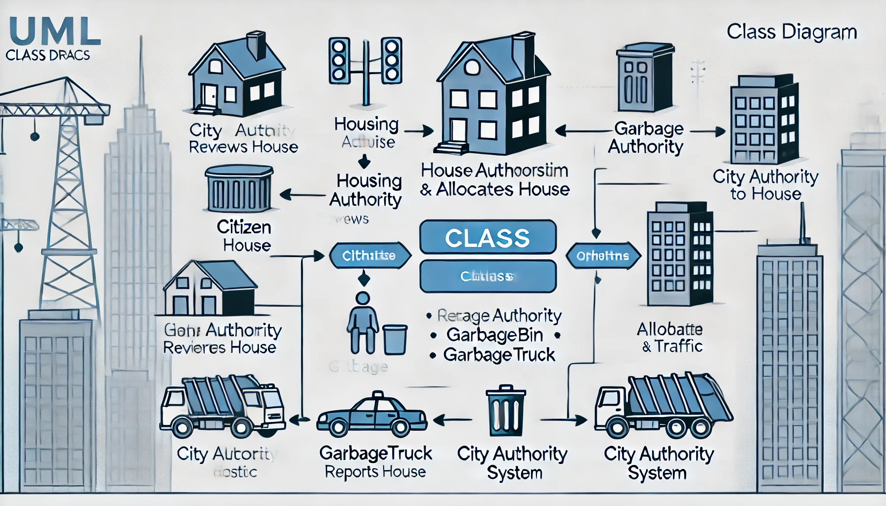
UML Diagram
Notes:
+-----------------+ | Citizen | +-----------------+ | - citizenId: int| | - name: String | | - income: double| | - familySize: int| | - address: String| +-----------------+ | +applyHousing(): void | | +reportGarbage(): void| | +reportTraffic(): void| +-----------------+ +-------------------+ | House | +-------------------+ | - houseId: int | | - location: String| | - size: int | | - allocatedTo: Citizen | +-------------------+ | +assignCitizen(c:Citizen): void | +-------------------+ +------------------------+ | HousingAuthority | +------------------------+ | - authorityId: int | | - name: String | +------------------------+ | +reviewApplication(c:Citizen): void| | +allocateHouse(c:Citizen, h:House): void| +------------------------+ +------------------------+ | GarbageBin | +------------------------+ | - binId: int | | - location: String | | - status: String | +------------------------+ | +updateStatus(): void | +------------------------+ +------------------------+ | GarbageTruck | +------------------------+ | - truckId: int | | - assignedZone: String | | - driver: String | +------------------------+ | +collectGarbage(): void| +------------------------+ +------------------------+ | TrafficSignal | +------------------------+ | - signalId: int | | - location: String | | - status: String | +------------------------+ | +adjustSignal(): void | +------------------------+ +------------------------+ | CityAuthoritySystem | +------------------------+ | - citizens: List<Citizen>| | - houses: List<House> | | - garbageTrucks: List<GarbageTruck> | | - trafficSignals: List<TrafficSignal>| +------------------------+ | +monitorHousing(): void | | +monitorGarbage(): void | | +monitorTraffic(): void | +------------------------+

Slide 19
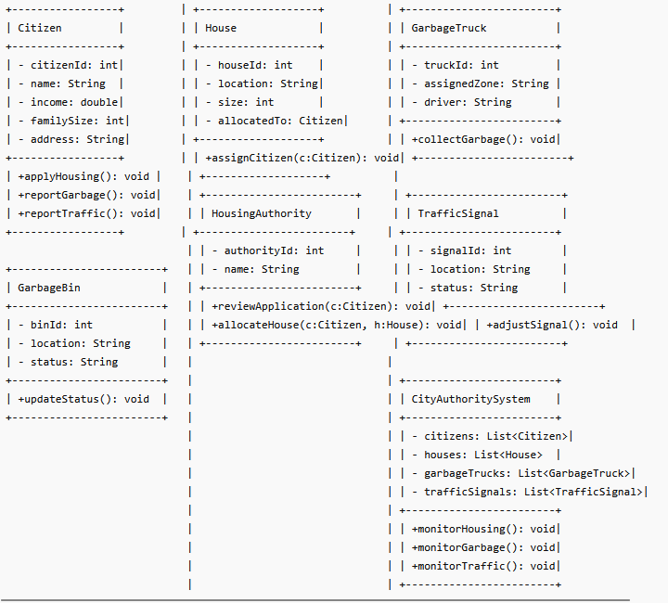
UML Diagram
Notes:
+-----------------+ | Citizen | +-----------------+ | - citizenId: int| | - name: String | | - income: double| | - familySize: int| | - address: String| +-----------------+ | +applyHousing(): void | | +reportGarbage(): void| | +reportTraffic(): void| +-----------------+ +-------------------+ | House | +-------------------+ | - houseId: int | | - location: String| | - size: int | | - allocatedTo: Citizen | +-------------------+ | +assignCitizen(c:Citizen): void | +-------------------+ +------------------------+ | HousingAuthority | +------------------------+ | - authorityId: int | | - name: String | +------------------------+ | +reviewApplication(c:Citizen): void| | +allocateHouse(c:Citizen, h:House): void| +------------------------+ +------------------------+ | GarbageBin | +------------------------+ | - binId: int | | - location: String | | - status: String | +------------------------+ | +updateStatus(): void | +------------------------+ +------------------------+ | GarbageTruck | +------------------------+ | - truckId: int | | - assignedZone: String | | - driver: String | +------------------------+ | +collectGarbage(): void| +------------------------+ +------------------------+ | TrafficSignal | +------------------------+ | - signalId: int | | - location: String | | - status: String | +------------------------+ | +adjustSignal(): void | +------------------------+ +------------------------+ | CityAuthoritySystem | +------------------------+ | - citizens: List<Citizen>| | - houses: List<House> | | - garbageTrucks: List<GarbageTruck> | | - trafficSignals: List<TrafficSignal>| +------------------------+ | +monitorHousing(): void | | +monitorGarbage(): void | | +monitorTraffic(): void | +------------------------+

Slide 20
Sequential Model (Example for Housing Allocation)
Scenario: Citizen applies for housing → AI system suggests allocation → Housing Authority approves → Citizen notified.
Steps (Sequence Diagram in Text):
Citizen -> DUMS_UI: Submit Housing Application
DUMS_UI -> Database: Store Application Data
Database -> AI_Module: Analyze eligibility & generate allocation suggestion
AI_Module -> HousingAuthority: Send suggested allocation
HousingAuthority -> AI_Module: Approve or adjust suggestion
HousingAuthority -> Database: Update house allocation
Database -> DUMS_UI: Notify citizen of allocation
DUMS_UI -> Citizen: Display allocated house
Similarly, garbage collection and traffic control sequences follow:
Garbage: Citizen reports → System identifies zone → Assign truck → Truck collects → Citizen notified
Traffic: System monitors sensors → Detect congestion → Adjust traffic signal → Notify officer → Log for analytics
Notes:
+-----------------+ | Citizen | +-----------------+ | - citizenId: int| | - name: String | | - income: double| | - familySize: int| | - address: String| +-----------------+ | +applyHousing(): void | | +reportGarbage(): void| | +reportTraffic(): void| +-----------------+ +-------------------+ | House | +-------------------+ | - houseId: int | | - location: String| | - size: int | | - allocatedTo: Citizen | +-------------------+ | +assignCitizen(c:Citizen): void | +-------------------+ +------------------------+ | HousingAuthority | +------------------------+ | - authorityId: int | | - name: String | +------------------------+ | +reviewApplication(c:Citizen): void| | +allocateHouse(c:Citizen, h:House): void| +------------------------+ +------------------------+ | GarbageBin | +------------------------+ | - binId: int | | - location: String | | - status: String | +------------------------+ | +updateStatus(): void | +------------------------+ +------------------------+ | GarbageTruck | +------------------------+ | - truckId: int | | - assignedZone: String | | - driver: String | +------------------------+ | +collectGarbage(): void| +------------------------+ +------------------------+ | TrafficSignal | +------------------------+ | - signalId: int | | - location: String | | - status: String | +------------------------+ | +adjustSignal(): void | +------------------------+ +------------------------+ | CityAuthoritySystem | +------------------------+ | - citizens: List<Citizen>| | - houses: List<House> | | - garbageTrucks: List<GarbageTruck> | | - trafficSignals: List<TrafficSignal>| +------------------------+ | +monitorHousing(): void | | +monitorGarbage(): void | | +monitorTraffic(): void | +------------------------+

Slide 21
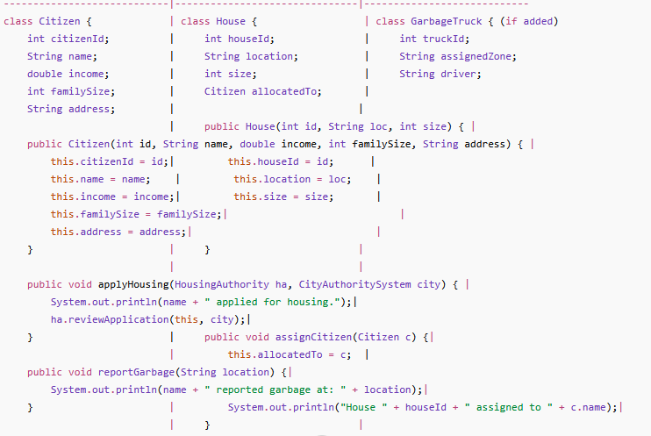
Java Code Skeleton (Basic OOP Implementation)
Simplified Java version to illustrate the core functionality:
Notes:
import java.util.*;class Citizen { int citizenId; String name; double income; int familySize; String address; public Citizen(int id, String name, double income, int familySize, String address) { this.citizenId = id; this.name = name; this.income = income; this.familySize = familySize; this.address = address; } public void applyHousing(HousingAuthority ha, CityAuthoritySystem city) { System.out.println(name + " applied for housing."); ha.reviewApplication(this, city); } public void reportGarbage(String location) { System.out.println(name + " reported garbage at: " + location); } public void reportTraffic(String location) { System.out.println(name + " reported traffic issue at: " + location); }}class House { int houseId; String location; int size; Citizen allocatedTo; public House(int id, String loc, int size) { this.houseId = id; this.location = loc; this.size = size; } public void assignCitizen(Citizen c) { this.allocatedTo = c; System.out.println("House " + houseId + " assigned to " + c.name); }}class HousingAuthority { int authorityId; String name; public HousingAuthority(int id, String name) { this.authorityId = id; this.name = name; } public void reviewApplication(Citizen c, CityAuthoritySystem city) { System.out.println("Housing Authority reviewing application of " + c.name); // Simple allocation logic: pick first available house for (House h : city.houses) { if (h.allocatedTo == null) { h.assignCitizen(c); break; } } }}class CityAuthoritySystem { List<Citizen> citizens = new ArrayList<>(); List<House> houses = new ArrayList<>(); public void addCitizen(Citizen c) { citizens.add(c); } public void addHouse(House h) { houses.add(h); } public void monitorHousing() { System.out.println("Monitoring housing allocation..."); for (House h : houses) { if (h.allocatedTo != null) { System.out.println("House " + h.houseId + " allocated to " + h.allocatedTo.name); } } }}// Main method to simulate scenariopublic class DUMSSystem { public static void main(String[] args) { CityAuthoritySystem city = new CityAuthoritySystem(); // Create houses city.addHouse(new House(1, "Gulshan", 1200)); city.addHouse(new House(2, "Banani", 900)); // Create citizens Citizen rahim = new Citizen(101, "Rahim", 15000, 4, "Old Dhaka"); city.addCitizen(rahim); HousingAuthority ha = new HousingAuthority(1, "Dhaka Housing Authority"); // Citizen applies for housing rahim.applyHousing(ha, city); // Monitor allocations city.monitorHousing(); }}

Slide 22
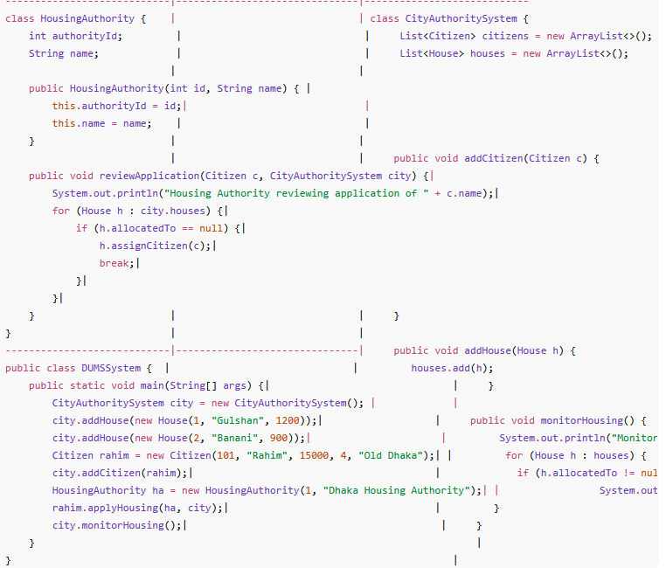
Java Code Skeleton (Basic OOP Implementation)
Simplified Java version to illustrate the core functionality:
Notes:
import java.util.*;class Citizen { int citizenId; String name; double income; int familySize; String address; public Citizen(int id, String name, double income, int familySize, String address) { this.citizenId = id; this.name = name; this.income = income; this.familySize = familySize; this.address = address; } public void applyHousing(HousingAuthority ha, CityAuthoritySystem city) { System.out.println(name + " applied for housing."); ha.reviewApplication(this, city); } public void reportGarbage(String location) { System.out.println(name + " reported garbage at: " + location); } public void reportTraffic(String location) { System.out.println(name + " reported traffic issue at: " + location); }}class House { int houseId; String location; int size; Citizen allocatedTo; public House(int id, String loc, int size) { this.houseId = id; this.location = loc; this.size = size; } public void assignCitizen(Citizen c) { this.allocatedTo = c; System.out.println("House " + houseId + " assigned to " + c.name); }}class HousingAuthority { int authorityId; String name; public HousingAuthority(int id, String name) { this.authorityId = id; this.name = name; } public void reviewApplication(Citizen c, CityAuthoritySystem city) { System.out.println("Housing Authority reviewing application of " + c.name); // Simple allocation logic: pick first available house for (House h : city.houses) { if (h.allocatedTo == null) { h.assignCitizen(c); break; } } }}class CityAuthoritySystem { List<Citizen> citizens = new ArrayList<>(); List<House> houses = new ArrayList<>(); public void addCitizen(Citizen c) { citizens.add(c); } public void addHouse(House h) { houses.add(h); } public void monitorHousing() { System.out.println("Monitoring housing allocation..."); for (House h : houses) { if (h.allocatedTo != null) { System.out.println("House " + h.houseId + " allocated to " + h.allocatedTo.name); } } }}// Main method to simulate scenariopublic class DUMSSystem { public static void main(String[] args) { CityAuthoritySystem city = new CityAuthoritySystem(); // Create houses city.addHouse(new House(1, "Gulshan", 1200)); city.addHouse(new House(2, "Banani", 900)); // Create citizens Citizen rahim = new Citizen(101, "Rahim", 15000, 4, "Old Dhaka"); city.addCitizen(rahim); HousingAuthority ha = new HousingAuthority(1, "Dhaka Housing Authority"); // Citizen applies for housing rahim.applyHousing(ha, city); // Monitor allocations city.monitorHousing(); }}

Slide 23
Others Module
System Integration (High-Level Workflow)
User Interface (Web/Mobile App):
  Citizens apply for housing, report garbage issues, or submit traffic complaints.
  Government officials review data and take action.
Database:
  Stores applicant details, housing units, garbage zones, and traffic signals.
AI/ML Components:
  Predictive housing allocation.
  Optimal garbage truck routing and Smart traffic light automation.
APIs for External Systems:
  Dhaka City Corporation (garbage trucks).
  BRTA (traffic management).

Slide 24
System Scenario-2: "Agricultural Automation System (AAS)”
Agriculture is one of the most important sectors in Bangladesh. Farmers face several challenges:
  Inefficient irrigation management
  Excessive fertilizer usage
  Pest and weed attacks
  Labor shortages
  Low crop yield prediction accuracy
  Delayed harvesting decisions
The Agricultural Automation System (AAS) is a centralized smart farming platform designed to automate the rice cultivation process using IoT sensors, AI/ML, drones, and automated machinery.
The system can be accessed through web and mobile applications by farmers, agricultural officers, field workers, and farm managers.
The system continuously collects field data from sensors and cameras and automatically controls irrigation, fertilization, pest control, and harvesting operations.

Slide 25
System Goal
Develop a smart farming platform that:
  Monitors crop growth
  Controls irrigation automatically
  Detects diseases and pests
  Optimizes fertilizer application
  Predicts harvesting time
  Increases crop production

Slide 26
AAS Main Modules
1.Field Preparation Module
Responsibilities:
  Register farm land
  Analyze soil condition
  Measure pH level
  Detect moisture level
  Prepare cultivation schedule
Input:
  Soil sensor data
  Farmer information
Output:
  Land readiness report
2.Planting Module
Responsibilities:
  Manage seed information
  Schedule planting
  Control automatic seed planter
Input:
  Seed type
  Field information
Output:
  Planting confirmation

Slide 27
AAS Main Modules
3.Irrigation Control Module
Responsibilities:
  Monitor soil moisture
  Control water pumps
  Manage irrigation schedules
Input:
  Moisture sensors
  Weather forecast
Output:
  Automatic irrigation decision
4. Fertilization Module
Responsibilities:
  Monitor nutrient levels
  Calculate fertilizer requirements
  Schedule fertilizer application
Input:
  Soil nutrients
  Crop growth stage
Output:
  Fertilizer recommendation

Slide 28
AAS Main Modules
5. Pest & Weed Control Module
Responsibilities:
  Detect pests using camera images
  Detect weeds
  Recommend pesticide usage
  Control spraying drones
Input:
  Drone images
  Camera feeds
Output:
  Pest treatment plan
6. Growth Monitoring Module
Responsibilities:
  Monitor plant growth
  Calculate crop health index
  Estimate yield
Input:
  Drone images
  Sensor data
Output:
  Growth report

Slide 29
AAS Main Modules
7. Harvesting Module
Responsibilities:
  Predict harvesting date
  Control harvesting machines
Input:
  Growth stage
  Weather condition
Output:
  Harvest schedule
8. Post-Harvest Module
Responsibilities:
  Store harvested rice
  Manage transportation
  Track warehouse inventory
Input:
  Harvest quantity
Output:
  Storage report

Slide 30
AAS Main Modules
9. Central Control System
  Responsibilities:
  Coordinate all modules
  Store data
  Generate reports
  Run AI prediction models

Slide 31
AAS Main Modules
Step-1: Understanding the Problem Domain
Main Actors
  Human Actors
    Farmer
    Agricultural Officer
    Farm Manager
    Drone Operator
  System Actors
    Soil Sensor
    Moisture Sensor
    Weather API
    AI/ML Prediction Engine
    Irrigation Pump
    Drone Sprayer
    Harvesting Machine

Slide 32
Use Case 1:
Smart Irrigation Control
Goal
  Automatically irrigate fields based on
  soil moisture and weather conditions.
Primary Actor
  Farmer
Supporting Actors
  Moisture Sensor
  Weather API
  Irrigation Pump
  AI Irrigation System
Preconditions
  Sensors are connected.
  Irrigation pumps are registered.
Main Scenario
Moisture sensors continuously monitor soil.
Soil moisture drops below threshold.
Sensor sends data to AAS.
Weather API provides forecast.
AI module analyzes moisture and weather.
System decides irrigation is necessary.
Pump receives activation command.
Water is supplied automatically.
Moisture reaches target level.
Pump stops.
Farmer receives notification.
Alternative Scenario
  If rain is expected within a few hours, irrigation is postponed.
Output
  Efficient water management.

Slide 33
Use Case 2
Pest Detection and Control
Goal
Automatically detect and control pest attacks.
Primary Actor
Agricultural Officer
Supporting Actors
Drone Camera
AI Vision System
Drone Sprayer
Preconditions
Drone system operational.
Main Scenario
Drone captures field images.
Images uploaded to AAS.
AI detects pest infection.
Infection severity calculated.
Treatment recommendation generated.
Agricultural Officer approves.
Sprayer drone receives task.
Pesticide sprayed.
Treatment report stored.
Farmer notified.
Alternative Scenario
If no pest is detected, monitoring continues.
Output
Reduced crop loss.

Slide 34
Use Case 3
Harvest Prediction and Scheduling
Goal
Predict optimal harvesting time.
Primary Actor
Farm Manager
Supporting Actors
Growth Monitoring Module
Weather API
Harvesting Machine
Preconditions
Crop growth data available.
Main Scenario
Growth module analyzes crop maturity.
Weather forecast retrieved.
AI predicts harvesting date.
Harvest schedule generated.
Manager reviews schedule.
Harvesting machine assigned.
Harvest operation completed.
Storage information updated.
Alternative Scenario
If severe weather is expected, harvesting date is adjusted.
Output
Timely harvesting and reduced crop damage.

Slide 35
Integrated Scenario:
A Day in Smart Farming Managed by AAS
In the morning, soil moisture sensors detect that water levels are below the required threshold. The Irrigation Control Module consults weather forecasts and automatically activates irrigation pumps.
Later, drones fly over the rice field and capture images. The Pest & Weed Control Module analyzes the images and detects a pest outbreak in one section of the farm. The Agricultural Officer approves the treatment recommendation, and a spraying drone applies pesticide automatically.
In the afternoon, the Growth Monitoring Module evaluates crop maturity and predicts that harvesting should begin within five days. The Harvesting Module schedules harvesting machinery and updates the farmer.
Throughout the day, the Central Control System collects data from all modules and provides real-time reports through the farmer’s mobile application.
The AAS enables data-driven, automated, and efficient farming operations while improving crop yield and reducing labor costs.
Notes:
Dhaka Urban Management System (Citizen, MunicipalService, Complaint)

Slide 36
OOAD – Main Classes (Domain Model)
IrrigationController
FertilizerController
PestController
GrowthMonitor
HarvestManager
Drone
SprayerDrone
HarvestMachine
WeatherService
AIEngine
ReportGenerator
Farmer
AgriculturalOfficer
FarmManager
Field
Crop
Sensor
SoilSensor
MoistureSensor
Notes:
Dhaka Urban Management System (Citizen, MunicipalService, Complaint)

Slide 37
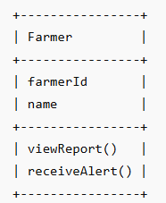
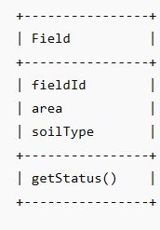
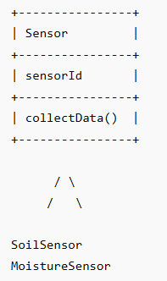
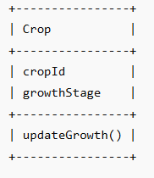
OOAD – Main Classes (Domain Model)
Notes:
Dhaka Urban Management System (Citizen, MunicipalService, Complaint)

Slide 38
Suitable Design Patterns for AAS
Module | Design Pattern
Central Control System | Singleton
Sensor Notification | Observer
AI Decision Engine | Strategy
Report Generation | Factory
Irrigation Controller | Command
Drone Control | Adapter
Module Integration | Facade
Notes:
Dhaka Urban Management System (Citizen, MunicipalService, Complaint)

Slide 39
Example UML Sequence Diagram (Irrigation)
Farmer
|
MoistureSensor
|
AIEngine
|
IrrigationController
|
WaterPump
Sensor -> AIEngine : sendData()
AIEngine -> Controller : irrigate()
Controller -> Pump : start()
Pump -> Controller : completed()
Controller -> Farmer : notify()
Notes:
Dhaka Urban Management System (Citizen, MunicipalService, Complaint)

Slide 40
Simple Python Demonstration (Observer Pattern)
class Farmer:
def update(self, message):
print("Farmer Notification:", message)
class MoistureSensor:
def __init__(self):
self.observers = []
def attach(self, observer):
self.observers.append(observer)
def notify(self, message):
for observer in self.observers:
observer.update(message)
def check_moisture(self, level):
if level < 30:
self.notify(
"Soil moisture is low. Irrigation started." )
farmer = Farmer()
sensor = MoistureSensor()
sensor.attach(farmer)
sensor.check_moisture(25)
Output:
  Farmer Notification:
  Soil moisture is low. Irrigation started.
Notes:
Dhaka Urban Management System (Citizen, MunicipalService, Complaint)

Slide 41
Real world object and Benifit
The benefit of representing real-world entities—such as Farmer, SensorModule, and IrrigationController—in the Automated Agricultural System as objects in your code.
Modeling Farmer, SensorModule, and IrrigationController as objects helps create a clear, modular structure. Each object manages its own functions—such as monitoring soil data or controlling irrigation—making the system easier to update, automate, and integrate. This improves reliability, simplifies troubleshooting, and supports smart, data-driven farming.
Notes:
Dhaka Urban Management System (Citizen, MunicipalService, Complaint)

Slide 42
Why "Good software design begins before coding"?
Key Concept: Design is a blueprint; coding is implementation.
If the design is weak, the software will be hard to understand, extend, or maintain.
A good design ensures:
  Clear structure
  Easier debugging and testing
  Flexibility for future changes
Before writing code for housing allocation, we:
  Identified core problems (overpopulation, garbage, traffic).
  Defined requirements (e.g., "Applicants must submit income proof").
  Designed classes (Applicant, HousingUnit) and workflows.

Slide 43
Establishing Initial Software Requirements
Key Concept: Gather what the system must do (functional) and should do (non-functional).
DUMS Example:
Functional Requirements:
  Citizens can apply for housing online.
  Garbage trucks are assigned based on zone complaints.
Non-Functional Requirements:
  Scalable to 10M users (Dhaka’s population).
  Real-time traffic signal updates (<1 sec latency).

Slide 44
OOAD Main Activities : 1. Conceptual Design
Focuses on what the system should do
Key Concept: High-level architecture without technical details.
Involves understanding the problem key objects, classes, and their relationships.
DUMS Example:
Entities/Objects Identified:
  Applicant, HousingUnit, GarbageZone, TrafficSignal.
Relationship:
  A Citizen submits a Complaint linked to a GarbageZone.
  Housing Allocation System matches Applicant to HousingUnit.
Notes:
Example: In a library system:
Objects: Book, Member, Librarian, Loan.
Relationships: A Member borrows a Book.

Slide 45
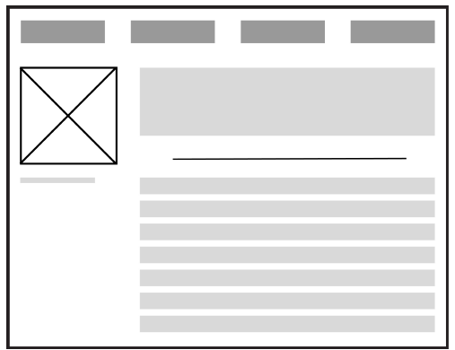
OOAD Main Activities : 1. Conceptual Design
The conceptual design recognizes appropriate components, connections, and responsibilities of the software product.
Conceptual designs are expressed or communicated through conceptual mock-ups.
A visual notations that provide initial thoughts for how requirements will be satisfied.
Mock-ups for software involving user interfaces are often presented as wireframes, which are a kind of blueprint or basic visual representation of the product.
Notes:
Example: In a library system:
Objects: Book, Member, Librarian, Loan.
Relationships: A Member borrows a Book.

Slide 46
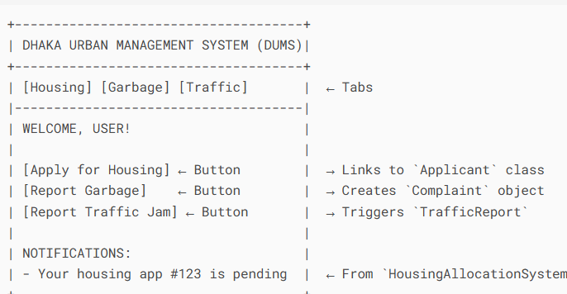
OOAD Main Activities : 1. Conceptual Design
Mock-ups show major components and their relations.
They help identify missing or problematic parts, requiring clarification or further conceptual design.
Each component has specific responsibilities.
Mock-ups focus on structure, not technical details.
Notes:
Example: In a library system:
Objects: Book, Member, Librarian, Loan.
Relationships: A Member borrows a Book.

Slide 47
OOAD Main Activities : 1. Conceptual Design
Purpose and Role of Conceptual Mock-ups
Visualize OO Concepts
  Example: UML class diagrams for an Order-Product relationship.
Validate Design Early
  Example: Wireframes showing how Cart and Checkout classes interact.
Bridge Client-Developer Gaps
  Example: A mock-up of a Dashboard class with widgets (client thinks "features", dev thinks "composition").
Tools:
  UML Diagrams (Class, Sequence)
  Wireframing tools (Figma, Balsamiq)
Notes:
Example: In a library system:
Objects: Book, Member, Librarian, Loan.
Relationships: A Member borrows a Book.

Slide 48
Conceptual Mock-ups illustrate in the Software Design process
Conceptual mock-ups are visual representations of how the system will look and behave before implementation. They illustrate:
User Interface (UI) Flow – how users navigate screens.
System Behavior – expected actions when users interact with components.
Requirements Validation – clients can confirm if the design matches their needs.
Communication Tool – bridges the gap between designers, developers, and stakeholders.
For example, a conceptual mock-up of a banking app may show:
  Login screen → Dashboard → Transfer Money form → Confirmation screen.
  This allows the client to approve the design before coding begins.
Conceptual mock-ups illustrate the look-and-feel, functionality, and usability of the software, reducing misunderstandings between clients and developers.
Notes:
Example: In a library system:
Objects: Book, Member, Librarian, Loan.
Relationships: A Member borrows a Book.

Slide 49
OOAD Main Activities : 2.Technical Design
Key Concept: Low-level implementation plans (algorithms, data structures).
Builds on conceptual design to define the technical details of the solution.
Conceptual design = outlines major components, connections, and responsibilities.
Technical design = explains how responsibilities are implemented.
Components are refined into smaller, detailed parts until each has clear technical specifications.
Technical diagrams are used to:
  Visualize structure and behavior of components.
  Capture details not shown in conceptual mock-ups.
Example:
  Kitchen = a component of a house.
  Technical design refines it further (e.g., flooring material must be easy to clean if cooking is frequent).

Slide 50
OOAD Main Activities : 2.Technical Design
Key Concept: Low-level implementation plans (algorithms, data structures).
DUMS Example:
Algorithms:
  Housing allocation uses a priority queue (income-based ranking).
  Traffic control uses Dijkstra’s algorithm for emergency vehicle routing.
Database Schema:
  Applicants table with fields: income, family_size.

Slide 51
OOAD Main Activities : 2.Technical Design
Aspect | Conceptual Design | Technical Design
Purpose | Defines what the system should do (major components and their responsibilities). | Defines how the system will work (detailed implementation of each component).
Detail Level | High-level overview, not very specific. | Low-level detail, refined until every part is well-defined.
Focus | Identifies major components and their interactions. | Specifies internal structure, materials, methods, and technical details.
Tools | Mock-ups, conceptual diagrams. | Technical diagrams (UML, architecture diagrams, flowcharts, etc.).
House Example | Kitchen is a component of the house. | Kitchen requires flooring; flooring must be easy to clean for frequent cooking use.
Software Example | User Management Module exists in the system. | User Management Module requires login with encryption, password reset via email.

Slide 52
Compromise in Requirements and Design
Compromises may be needed to create an acceptable solution.
Communication and feedback with the client are essential.
Example: Client wants an open kitchen, but structural support (post/beam)
may require adjustment → compromise needed.
Designs may need rework if:
  Conceptual design cannot be achieved in technical design.
  Requirements are not fully met.
Early validation is critical:
  Easier to revise during planning than after coding starts.
Larger systems = more design time, more components, more refinements.
Final agreed design → technical diagrams form the blueprint for construction/implementation.

Slide 53
Design for Quality Attributes
Broader view in design: Designing a software system so that it not only performs its required functions but also achieves important non-functional requirements (quality attributes) such as performance, convenience, security, reliability, usability, and maintainabilit
Trade-offs are common:
  Functional Requirements define what the system should do.
  Quality attributes define how well it should work.
Key quality attributes: Making architectural and design decisions that help the software achieve these desired qualities
Competing attributes: improving one may weaken another.
Software architects’ role:
  Continuously balance attributes.
  Decide which attribute is more critical in a given context.
Deadlines matter: time constraints affect feasibility of quality improvements.
Example (House Door):
  Too many locks = high security but low convenience.
  Good design balances security, convenience, and performance.
Notes:
Why is it Important?
A system may have all the required features but still fail if it performs poorly in terms of quality.
For example:
A university registration system allows students to register for courses (functional requirement).
However:
It takes 2 minutes to load a page.
It crashes when many students log in.
It is difficult to use.
Hackers can easily access student records.
Although the required functionality exists, the system is considered poorly designed because its quality attributes are inadequate.

Slide 54
Example: Online Shopping syste
Functional Requirements
The system should allow users to:
Register
Log in
Search products
Add items to the cart
Pay online
These describe what the system does.
Quality Attribute | Design Decision
Performance | Cache product pages to reduce load time
Security | Encrypt passwords and use HTTPS
Reliability | Maintain database backups and redundant servers
Usability | Provide a simple and intuitive interface
Maintainability | Organize the application into separate modules
Scalability | Use cloud infrastructure to support more users

Slide 55
Example: ATM System
Functional Requirements
  Withdraw cash
  Deposit money
  Check balance
Quality Attribute | Design Decision
Security | PIN verification and encrypted communication
Performance | Complete transactions within a few seconds
Reliability | Ensure operation even during network interruptions
Availability | Keep ATMs operational 24/7
Maintainability | Allow software updates without replacing the hardware

Slide 56
Context and Consequences in Design
Context matters:
  Different environments = different requirements.
  Example: Public-facing system needs stronger security than internal corporate system.
Consequences of design choices:
  Some decisions may cause problems later.
  Example: Solution works for small data but fails with large data.
Good practices:
  Seek feedback from other developers/stakeholders (design reviews).
  Prototype alternative ideas to compare approaches.
  Test thoroughly before full implementation.
  Use tests with different scenarios (e.g., small vs large data) to find limitations.

Slide 57
Satisfying Qualities in Software Design
Qualities come from requirements:
  Functional requirements = what the system should do.
  Non-functional requirements = how well the system should do it.
Functional requirements:
  Ensure correctness.
  Example: Music app must download and play songs.
Non-functional requirements:
  Focus on performance, efficiency, resource usage, maintainability, flexibility, reusability.
  Example: Music app can only download songs within a memory limit.
Requirements are often incomplete → clarified through client/end-user interactions.
Trade-offs and compromises may be needed due to constraints.
  Example: All cars provide transportation (functional), but differences in acceleration, fuel economy, and handling (non-functional) distinguish minivan vs. sports car.
Verification methods:
  Reviews and tests check if qualities are satisfied.
  End-user feedback validates real-world qualities.

Slide 58
Compromise in Software Design
Multiple perspectives matter:
  Users care about performance, usability.
  Developers care about reusability, maintainability.
Software structure affects both sides.
Common trade-offs:
  Performance vs. Maintainability
    High-performance code may be harder to understand/maintain.
    Backward compatibility may reduce both performance and maintainability.
  Performance vs. Security
    Stronger security adds overhead, lowering performance.
Balance qualities:
  Prioritize what is most important for the system.
  Ask: Can one quality be reduced slightly to improve another?

Slide 59
Importance of Design and Object-Oriented Thinking
Key Concept: OOAD promotes modularity, reusability, and maintainability.
  Encapsulation: Group data and behavior into a single unit (class).
  Abstraction: Focus only on essential features, ignoring details.
  Inheritance: Reuse common features by extending classes.
  Polymorphism: Same action behaves differently depending on the object.
These principles make the design more reusable, flexible, and easier to maintain.

Slide 60
Importance of Design and Object-Oriented Thinking
DUMS Example:
  Modularity: Each module (housing, garbage, traffic) is independent.
  Reusability: User class inherited by Citizen and Government Official.
  Maintainability: Changing garbage collection logic doesn’t break traffic module.

Slide 61
Class Responsibility Collaborator (CRC) Cards
Purpose:
  Represent components, responsibilities, and connections at a high level.
  A brainstorming tool for object-oriented design, help refine conceptual design.
Benefits:
  Organize system components into classes.
  Identify responsibilities of each class.
  Define how classes collaborate with others.
  Simple, visual tool to support brainstorming and design.
Structure of a CRC Card:
  Top → Class name.
  Left side → Responsibilities (tasks of the class).
  Right side → Collaborators (other classes it interacts with).
Analogy:
  Like index cards used for organizing talking points.
  Each card = one class in the system.
Each card represents a class:
  Class Name (e.g., Book)
  Responsibilities (what it does, e.g., "Store title, author")
  Collaborators (other classes it interacts with, e.g., Member)

Slide 62
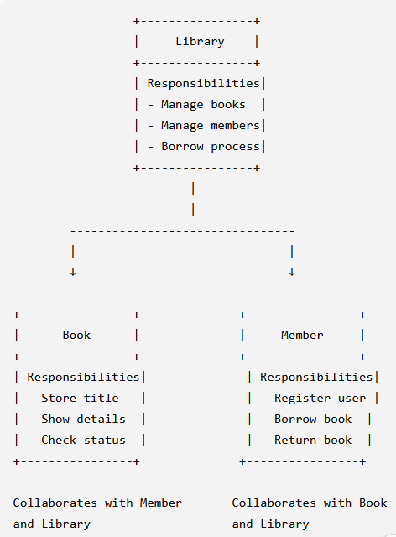
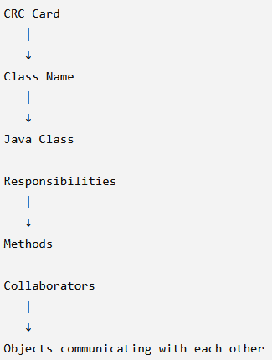
Class Responsibility Collaborator (CRC) Cards
Class | Responsibilities | Collaborators
Book | - Store book information- Display book details- Check availability | Member, Library
Member | - Register member- Borrow book- Return book | Book, Library
Library | - Manage books- Manage members- Process borrowing | Book, Member

Slide 63
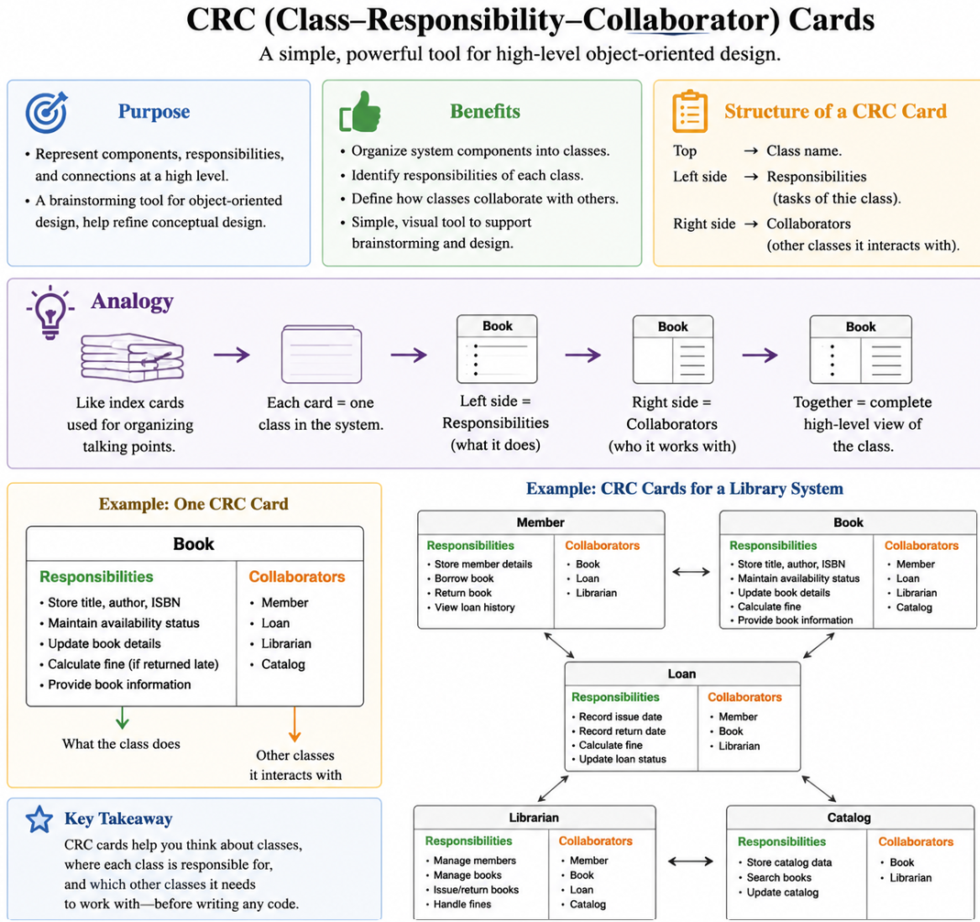

Slide 64
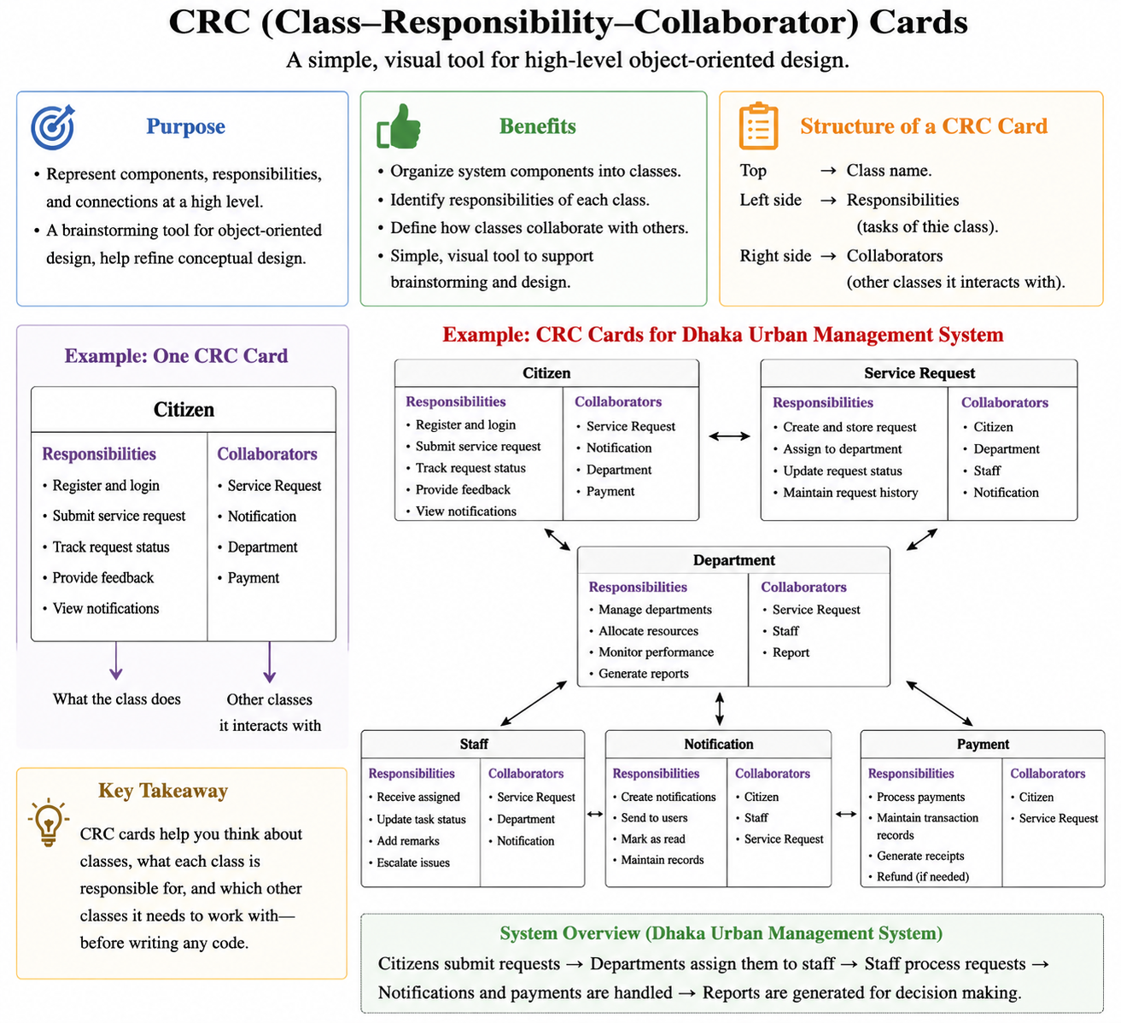
Purpose:
  Represent components, responsibilities, and connections at a high level.
  A brainstorming tool for object-oriented design, help refine conceptual design.
Benefits:
  Organize system components into classes.
  Identify responsibilities of each class.
  Define how classes collaborate with others.
  Simple, visual tool to support brainstorming and design.
Structure of a CRC Card:
  Top → Class name.
  Left side → Responsibilities (tasks of the class).
  Right side → Collaborators (other classes it interacts with).
Analogy:
  Like index cards used for organizing talking points.
  Each card = one class in the system.
Each card represents a class:
  Class Name (e.g., Book)
  Responsibilities (what it does, e.g., "Store title, author")
  Collaborators (other classes it interacts with, e.g., Member)

Slide 65
CRC Cards Technique
Key Concept: A brainstorming tool to design classes.
DUMS Example for Housing AllocationSystem:
How It Helps:
  Clarifies that Housing Allocation System needs Applicant data to function.
  Exposes missing links (e.g., "Should Applicant interact with Garbage Zone? No!").
Class | Responsibility | Collaborator
HousingAllocationSystem | Match applicants to housing units | Applicant, HousingUnit
Applicant | Provide personal/financial data | HousingAllocationSystem

Slide 66
Scenario: CRC Example
Problem: Consider a Dhaka Urban Management System scenario: a city resident logs into the smart city portal using their ID and password to verify their identity with the municipal database. The user is then provided options to report waste collection issues, pay utility bills, request road maintenance, or track service status. Explain how CRC (Class–Responsibility–Collaborator) cards can be utilized to isolate and define the system components, including their attributes, functionalities, and interactions — for example, classes such as Citizen, MunicipalService, Complaint, and Payment can be defined along with their responsibilities and collaborating relationships.
Using CRC Cards in the Dhaka Urban Management System
  CRC (Class–Responsibility–Collaborator) cards help break down the Dhaka Urban Management System into manageable components by defining what each class represents, what it is responsible for, and which other classes it interacts with. This method helps designers isolate key system features and understand how objects collaborate to complete tasks such as logging in, submitting complaints, or paying bills.
For example:
Citizen Class
  Responsibilities: Authenticate user credentials, manage user profile, initiate service requests.
  Collaborators: MunicipalService (to request services), Complaint (to report issues), Payment (to pay bills).

Slide 67
Scenario: CRC Example
MunicipalService Class
  Responsibilities: Provide access to available city services such as waste management, road repair, or bill inquiries.
  Collaborators: Citizen (service requester), Complaint (for issue reporting), Payment (for bill processing).
Complaint Class
  Responsibilities: Record waste collection issues, road maintenance requests, and other public service complaints.
  Collaborators: Citizen (complaint initiator), MunicipalService (service handling), ServiceStatus (to track progress).
Payment Class
  Responsibilities: Process utility bill payments, verify transaction details, and update user records.
  Collaborators: Citizen (payer), MunicipalService (billing information), TransactionGateway (processing).
  Using CRC cards makes it easier to identify each class’s attributes (e.g., CitizenID, ServiceType, ComplaintStatus), define their behaviors (e.g., login(), submitComplaint(), processPayment()), and outline how they interact within the system. This approach ensures better system design, promotes modularity, and simplifies implementation and future maintenance.

Slide 68
Scenario: CRC Example
+----------------+
| Citizen |
+----------------+
| - citizenID |
| - name |
| - password |
| - address |
+----------------+
| + login() |
| + requestSvc() |
| + payBill() |
+--------+-------+
|
| interacts with
v
+-----------------------+
| MunicipalService |
+-----------------------+
| - serviceID |
| - serviceType |
| - description |
+-----------------------+
| + getServices() |
| + assignService() |
+-----------+-----------+
|
+----------------------+
| interacts with |
v v
+------------------+ +--------------------+
| Complaint | | Payment |
+------------------+ +--------------------+
| - complaintID | | - paymentID |
| - type | | - billAmount |
| - status | | - paymentStatus |
+------------------+ +--------------------+
| + fileComplaint()| | + processPayment() |
| + trackStatus() | | + verifyDetails() |
+------------------+ +--------------------+
^ ^
| collaborates | collaborates
+-----------+-----------+
|
v
+----------------------+
| ServiceStatus |
+----------------------+
| - statusID |
| - statusDescription |
+----------------------+
| + updateStatus() |
| + getStatus() |
+----------------------+
Diagram Shows
Citizen interacts with:
  MunicipalService to request services
  Complaint to report issues
  Payment to pay bills
MunicipalService collaborates with:
  Complaint for issue handling
  Payment for bill-related operations
  ServiceStatus to update and trackpro
Complaint and Payment both interact with
ServiceStatus for tracking results or progress.

Slide 69
Scenario: CRC Example (Automated Agricultural System )
Problem: Consider an Automated Agricultural System scenario: a farmer accesses the automated control system through a mobile app, verifies their identity using a registered farm ID, and is then given options to monitor soil moisture, control irrigation pumps, check crop growth data, or analyze weather forecasts. Explain how CRC (Class–Responsibility–Collaborator) cards can be used to isolate and define the system components, including their attributes, functionalities, and interactions — for instance, classes like Farmer, SensorModule, IrrigationController, and WeatherService can be defined to represent various responsibilities and their collaborations in the automated process.

Slide 70
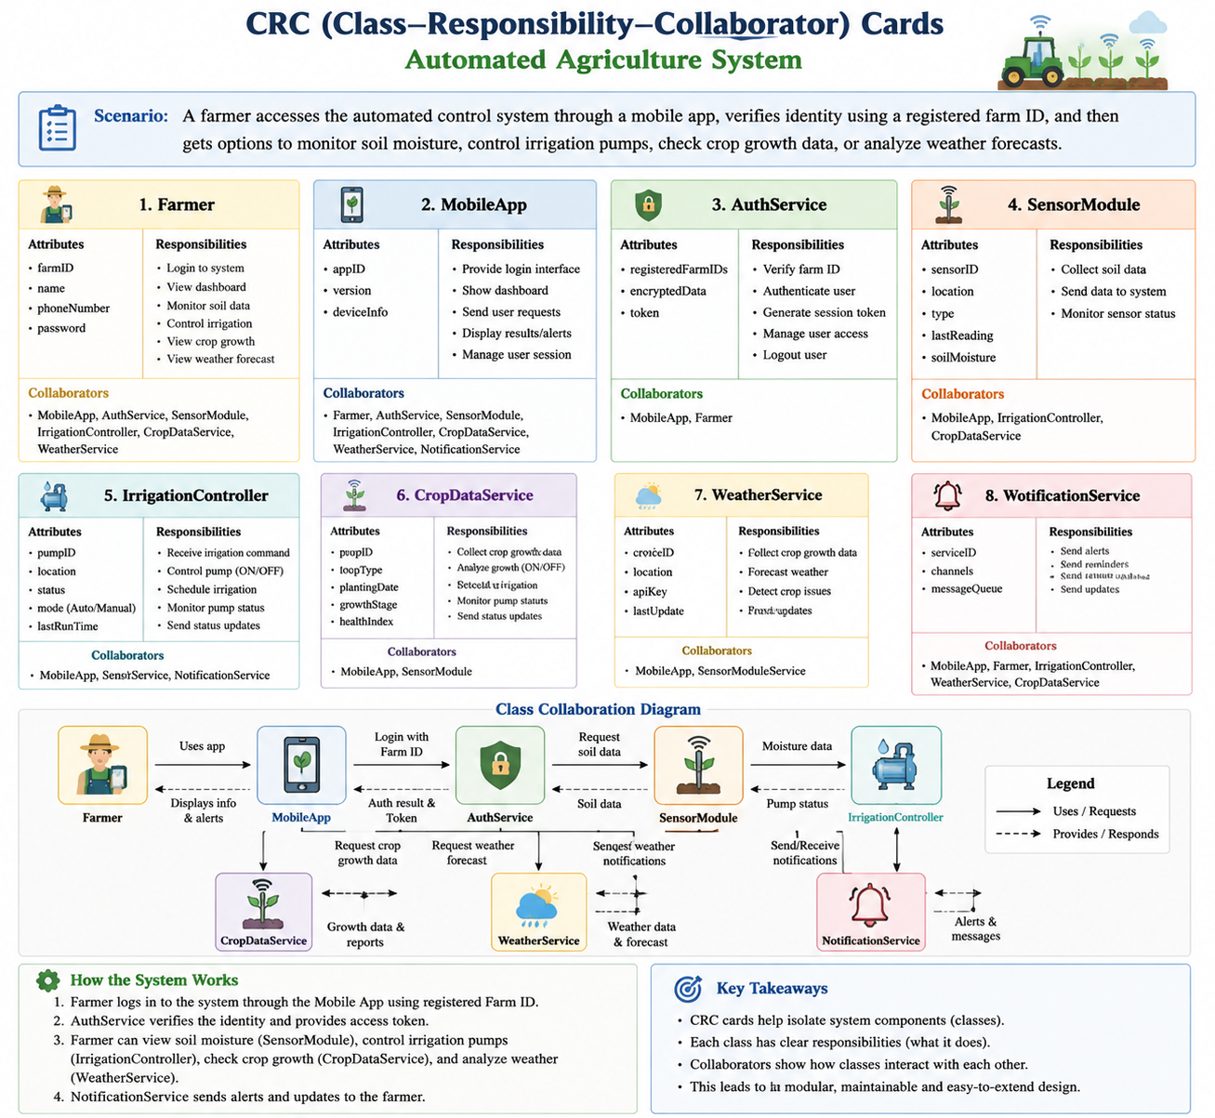
Scenario: CRC Example

Slide 71
Is IT possible to fail project work?
Poor Requirements Analysis
  If requirements are not captured correctly in the object model (use cases, class diagrams), the system may not meet the client’s expectations.
  Example: Missing a key user role in a DUMS leads to incomplete functionality.
  Building an e-commerce system without understanding payment gateway integration needs.
Incorrect Abstraction and Encapsulations
  Using too many low-level details in classes makes the design rigid and hard to extend.
  Example: Putting database logic inside UI classes instead of separating layers. Or Creating a monolithic User class instead of separate Customer, Admin, and Vendor subclasses.
  Weak Encapsulations: Exposing database connection details in a public class, leading to security risks.
Overuse of Inheritance
  Deep inheritance hierarchies make systems complex and fragile.
  Example: A vehicle class hierarchy with too many subclasses becomes unmanageable.
Notes:
-In terms of Object-oriented analysis and design—explain the situations in which a software project may fail.
-During the process of software design, what are the “Trade-offs between the client's need and Developer's Scope—
explain with an example-What Conceptual Mock-ups illustrate in the Software design process?

Slide 72
Is IT possible to fail project work?
Over-Engineering
  Example: Implementing a complex design pattern (e.g., Observer) for a simple notification system.
Poor Reusability and Maintainability
Mismatch Between Design and Implementation
Notes:
-In terms of Object-oriented analysis and design—explain the situations in which a software project may fail.
-During the process of software design, what are the “Trade-offs between the client's need and Developer's Scope—
explain with an example-What Conceptual Mock-ups illustrate in the Software design process?

Slide 73
Trade-offs between the client’s need and developer’s scope
In software design, trade-offs occur because clients usually want maximum functionality, low cost, and quick delivery, while developers must work within technical feasibility, resources, and time constraints. Key Trade-offs:
Functionality vs. Cost/Time
  Clients may demand advanced features, but developers must balance feasibility with budget and deadlines.
Performance vs. Flexibility
  Clients may want very high performance, while developers may prefer flexible, maintainable code.
Customization vs. Standardization
  Clients may request customized features, but developers may use standardized frameworks to reduce complexity.
Notes:
-In terms of Object-oriented analysis and design—explain the situations in which a software project may fail.
-During the process of software design, what are the “Trade-offs between the client's need and Developer's Scope—
explain with an example-What Conceptual Mock-ups illustrate in the Software design process?

Slide 74
Trade-offs between the client’s need and developer’s scope
In developing an E-commerce system,
  The client wants one-click checkout, real-time delivery tracking, and AI-based recommendations.
  The developer explains that implementing all at once would increase cost and delay delivery.
  Trade-off: The system is delivered with checkout and tracking first; AI recommendations are planned for a later release.
Trade-offs ensure the project is practical and deliverable while still meeting the essential client requirements.
Client Needs | Developer Constraints | Compromise
"I want all features in 2 months" | Realistic timeline is 6 months | Prioritize MVP (Minimum Viable Product)
"The app must work on all devices" | High testing overhead | Phase-wise rollout (Mobile-first, then desktop)
Notes:
Example:
Client: Wants a real-time multiplayer game with AI opponents.
Developer: Limited budget/time for AI development.
Trade-off: Launch with multiplayer first, add AI in Version 2.

Slide 75
Thank You (Q/A)

